Slide 1
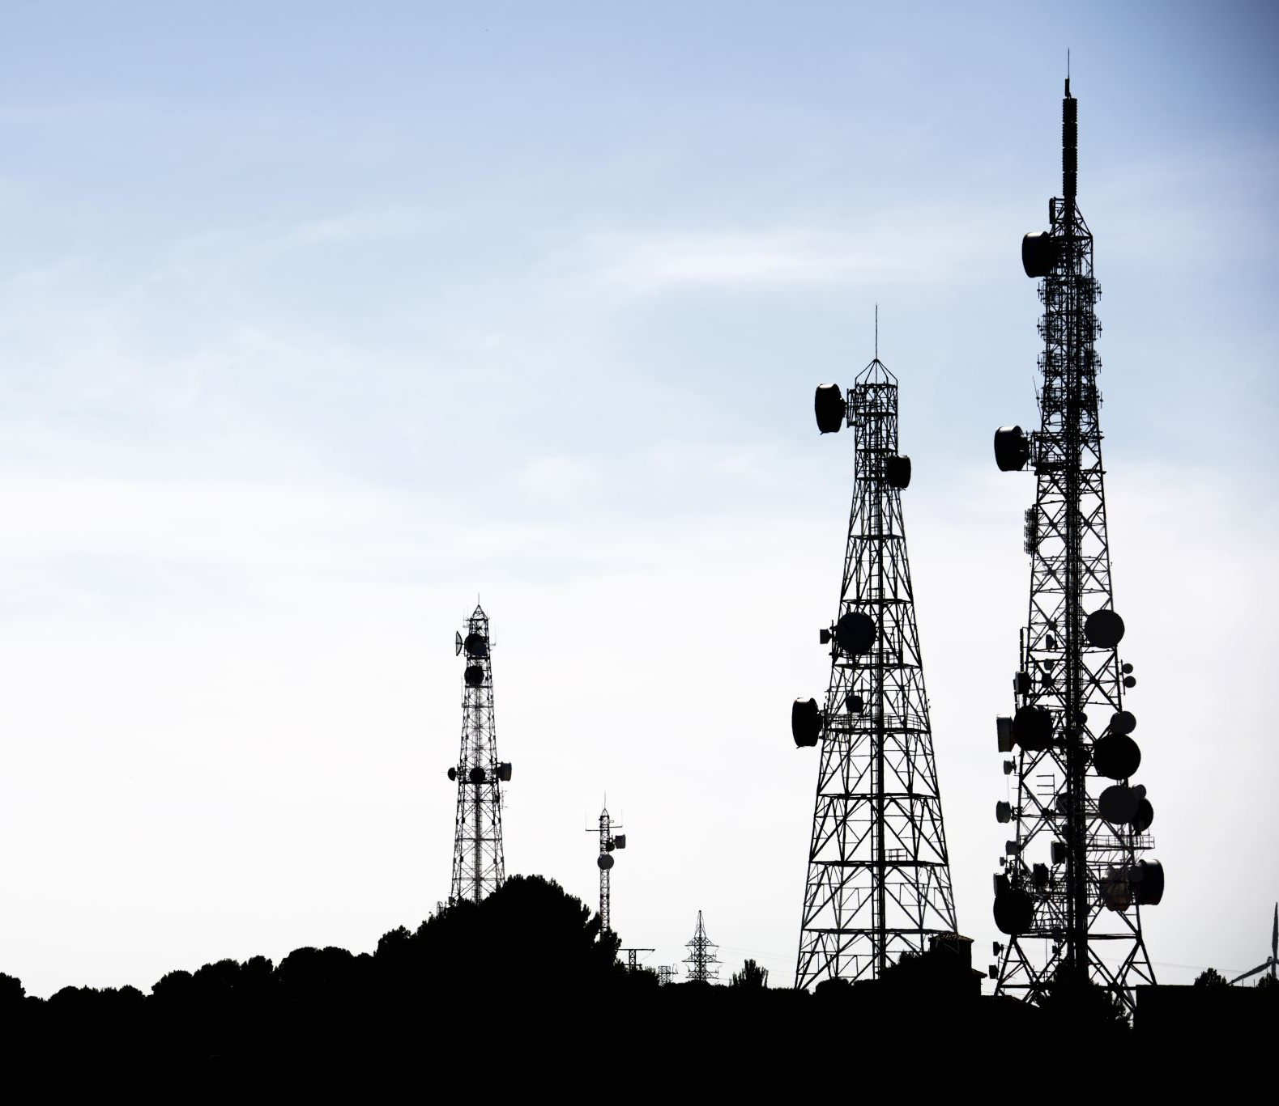
DJI Mavic Air Mobile Investigations
Android Phone
The Phone image and report are provided by vtolabs
Notes:
https://www.vtolabs.com/drone-forensics
https://digitalcorpora.s3.amazonaws.com/corpora/mobile/android_10/Non-Cellebrite%20Extraction/Pixel%203.zip

Slide 2
Overview
DJI Mavic Air
Analyze main flight record *.txt
Analyze video cache *.mp4
Analyze detailed flight record *.dat
Analyze cached pictures

Slide 3
DJI Mavic Air

Slide 4
Content
What is DJI Mavic Air?
Mavic Air Specs
Mavic Air Apps
Forensic evidence types
Data acquisition methods used for the lab

Slide 5
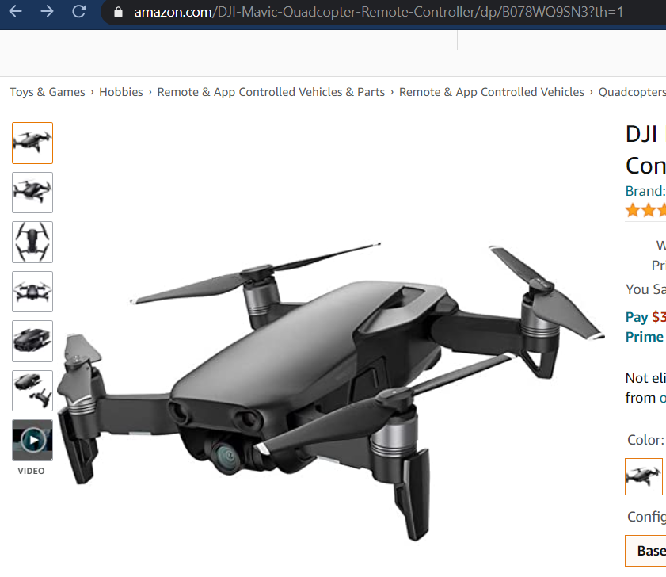
What is DJI Mavic Air?
The DJI Mavic Air was released in 2018.
It is the 3rd model in the DJI Mavic series.
DJI is a leading drone technology company
Privately owned
in China

Slide 6
Camera

Slide 7
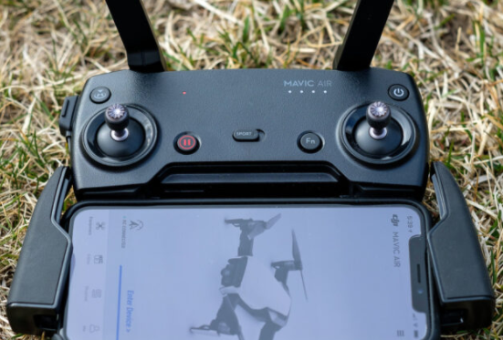
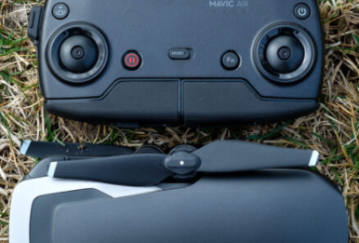
Mavic Air Controller
Notes:
https://photographylife.com/reviews/dji-mavic-air

Slide 8
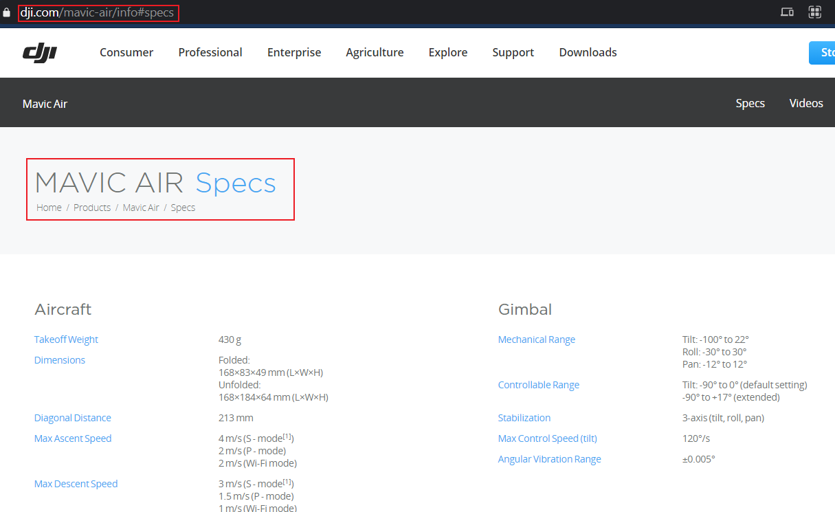
MAVIC AIR Specs
Notes:
https://www.dji.com/mavic-air/info#specs

Slide 9
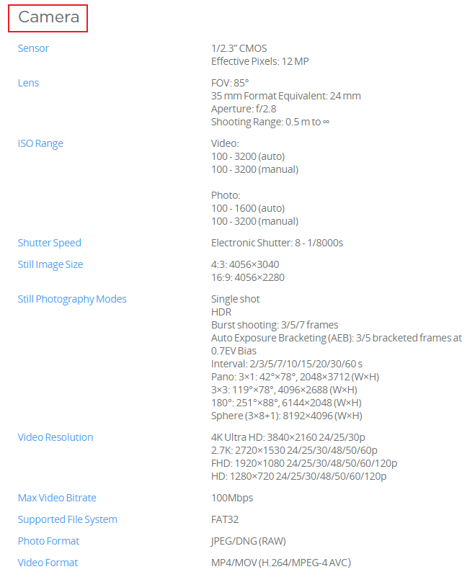
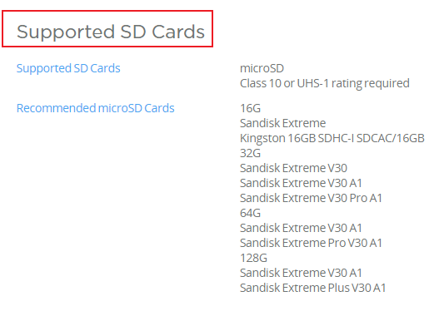
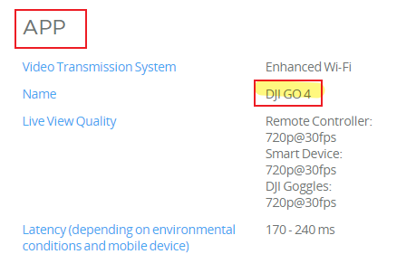

Slide 10
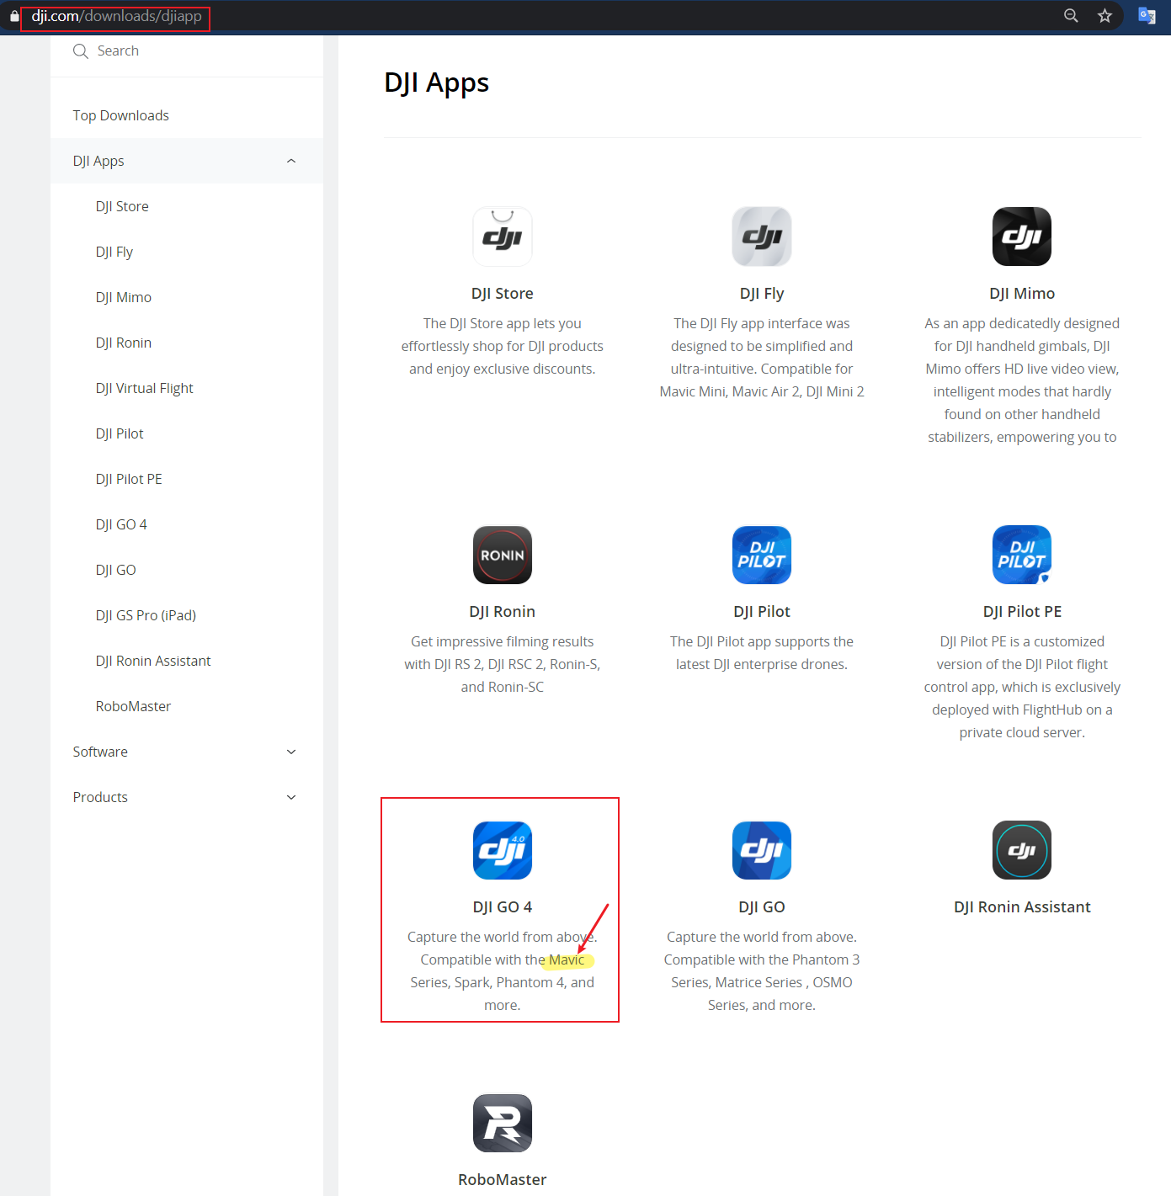
DJI Apps

Slide 11
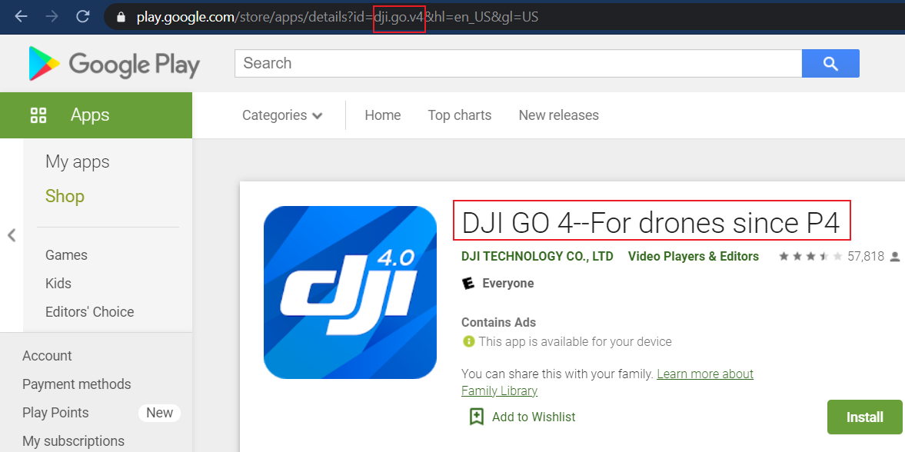
DJI GO 4--For drones since P4
package name: dji.go.v4

Slide 12
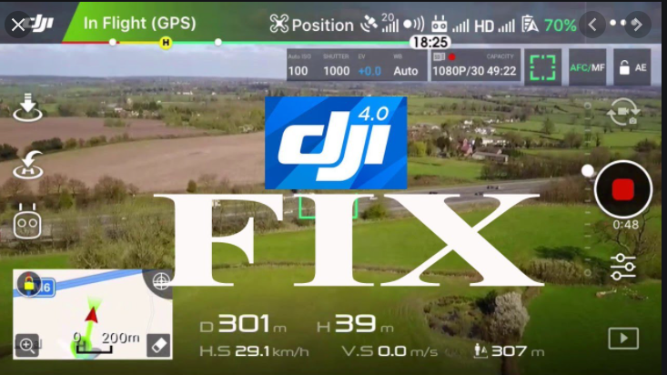
Notes:
https://www.youtube.com/watch?v=4ERyiZGUbVQ

Slide 13

DJI GO 4--For drones since P4
Compatible with the Mavic Series, Spark, Phantom 4, and more.
Features:
Near Real-time HD Image Transmission
Camera Settings Adjustment
Updated playback interface
Updated Editor with improved UI
More templates and music tracks in Editor
Convenient video downloading, editing and sharing
Integrated live streaming
Near real-time flight data recording

Slide 14
Forensic evidence types
P-GPS: The aircraft is using GPS for positioning.
Main Evidence Types | Other Evidence Types
Device (mobile/Drone) name Flight Timestamps/duration Flight speed Flight mode (e.g., Motor Started, AutoTakeoff, Autolanding, P-GPS, Manual) On Air Timestamps/duration Longitude, Latitude, Altitude Audio, Image, Video Distance To Home Flight Status/Mode Notification Battery name/information and Avoidance Weather (from timestamps) | Air pressure Altitude Acc X, Y, Z (Accelerometer) Gyro X, Y, Z (Gyroscope) Velocity North, East, Down, Valid Compass X, Y, Z Satellite Numbers Pitch, Roll, Yaw RC Input Pitch, Roll, Yaw RC Status RC Input Throttle Vision Height
Notes:
https://support.dronesmadeeasy.com/hc/en-us/articles/206034873-Setting-up-your-Drone-for-use-with-Map-Pilot
https://www.youtube.com/watch?v=AfS7gXmEDno

Slide 15
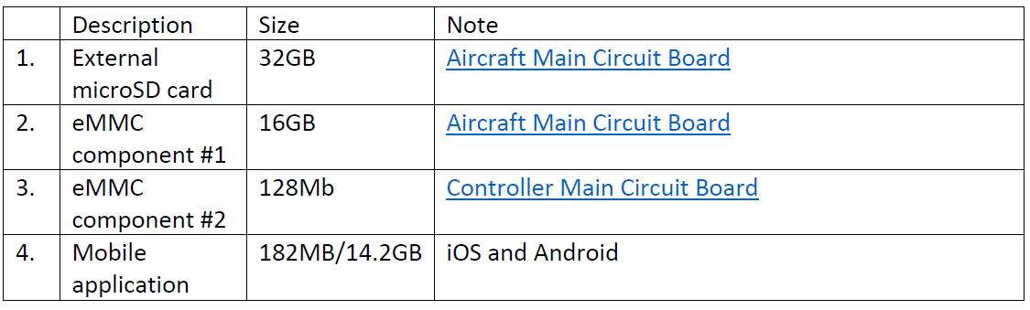
Data Acquisitions
The internal storage of the Mavic Air can be acquired by attaching the drone while powered on to your forensic workstation and imaging it as a standard USB drive.

Slide 16
Table : Flight Record Files
Device | Location | Desc | Example
Phone | Dji/dji.go.v4/FlightRecord | Main flight record (Motor on->Landed only ) | DJIFlightRecord_2018-06-19_[14-50-34].txt
 | Dji/dji.go.v4/DJI_Record | Video Cache (Takeoff->Landed only ) | 2018_06_19_14_50_39.mp4
 | Dji/dji.go.v4/FlightRecord/MCDatFlightRecords | Detailed flight record (PowerOn->PowerOff) | (20)18-06-19-02-47-38_FLY057.DAT
Mavic | Internal storage (DJI Assistant 2 to export) | Drone flight | DJI_ASSISTANT_EXPORT_FILE_2018_06_19_14_50_39.DAT

Slide 17

Analyze main flight record *.txt
Motor on -> Landed

Slide 18
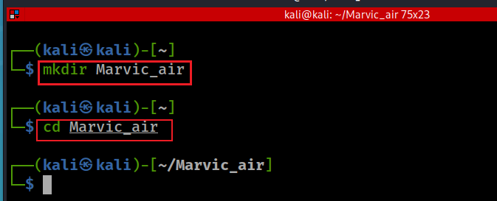
Create a working folder
sorry, typo here.
Notes:
mkdir Marvic_air
cd Marvic_air

Slide 19
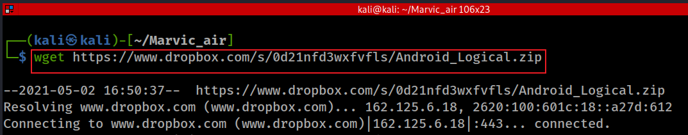
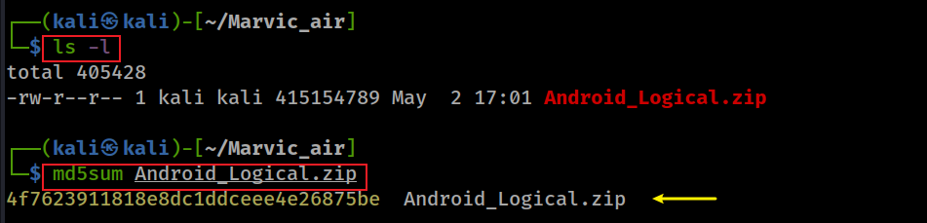
Download Android logical
Download zip
Verify md5
unzip
Notes:
wget https://www.dropbox.com/s/0d21nfd3wxfvfls/Android_Logical.zip
md5sum Android_Logical.zip

Slide 20
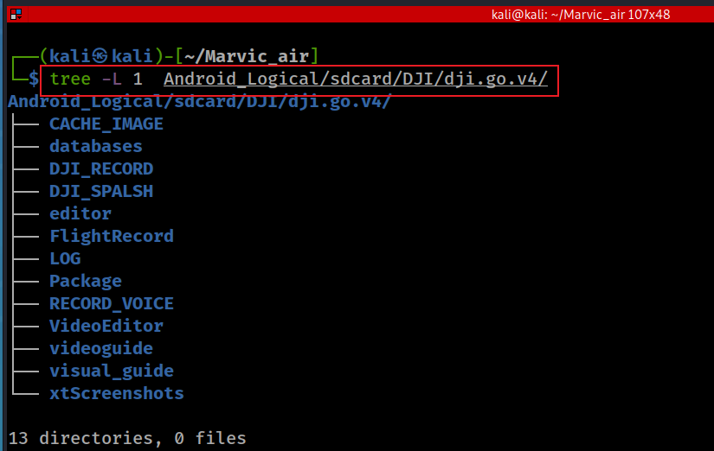
File Structure of DJI Go 4
Recorded flights
Definition of a flight
Motors ON-> Landed
Evidence collected
Almost all types
Not include video

Slide 21
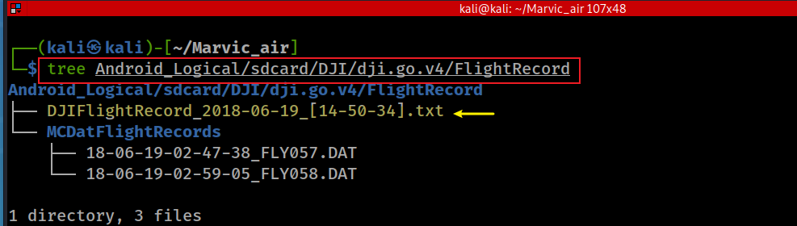
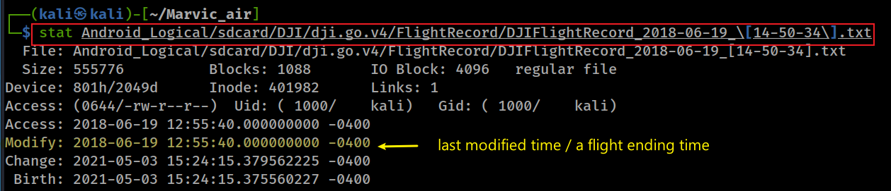
How to view a fight router information? (option 1: manual)
Find the flight starting and ending time
This is a local/motor ON. Need to find the UTC time.
Landed time in UTC: 2018-06-19 16:55:40
Notes:
stat Android_Logical/sdcard/DJI/dji.go.v4/FlightRecord/DJIFlightRecord_2018-06-19_\[14-50-34\].txt

Slide 22
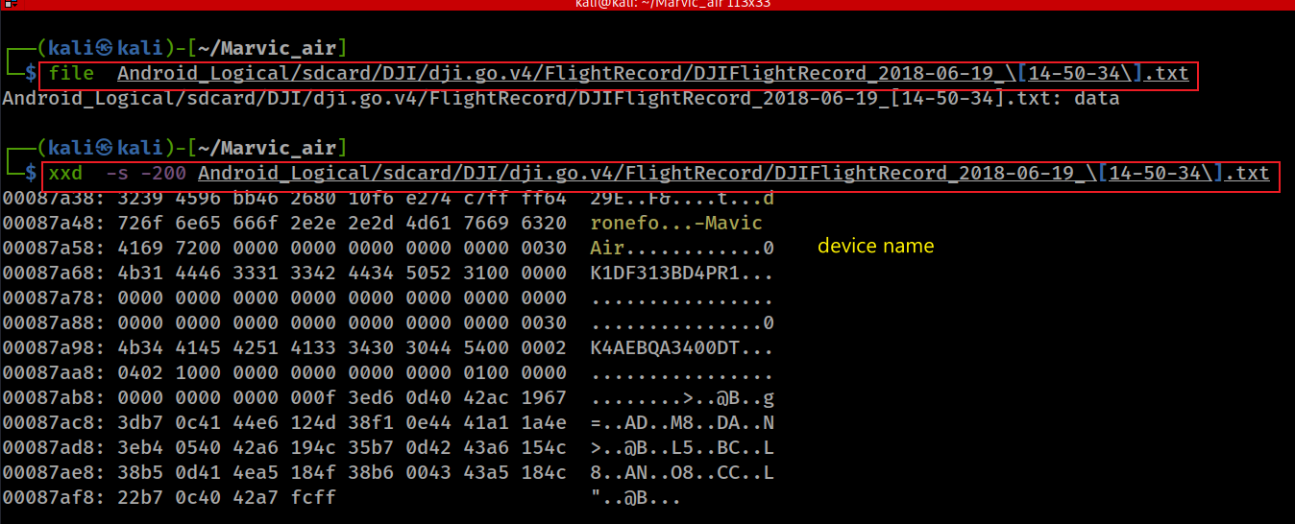
Find the flight device name
this .txt format has special format, we can’t interpreter the data without a parser/tool.

Slide 23
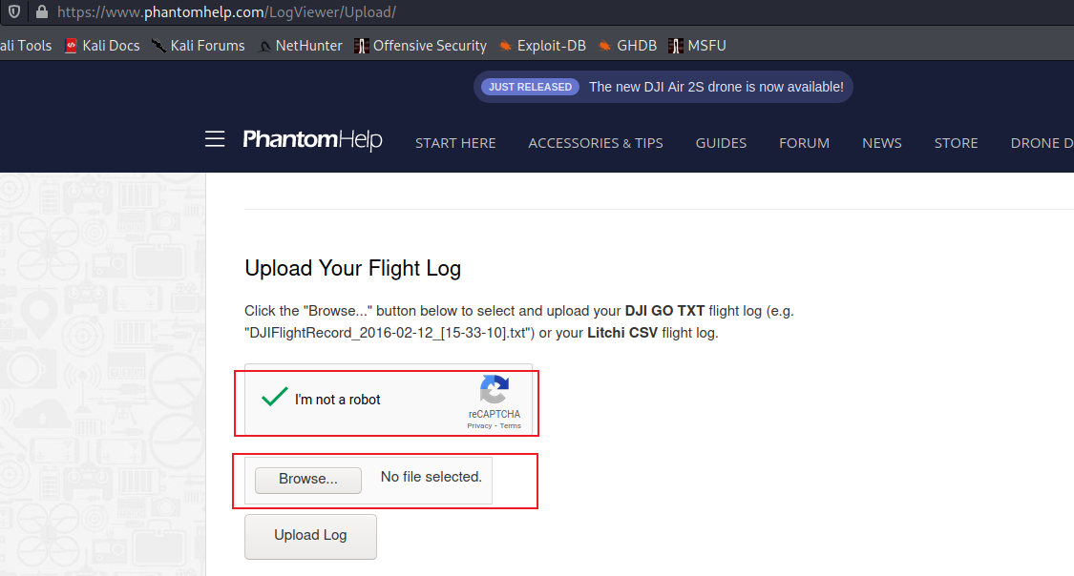
How to view a fight router information? (option 2: www.phantomhelp.com)
Notes:
https://www.phantomhelp.com/LogViewer/Upload/

Slide 24
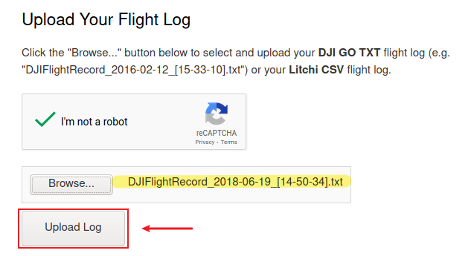
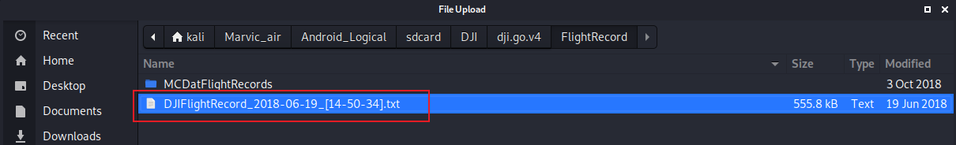

Slide 25
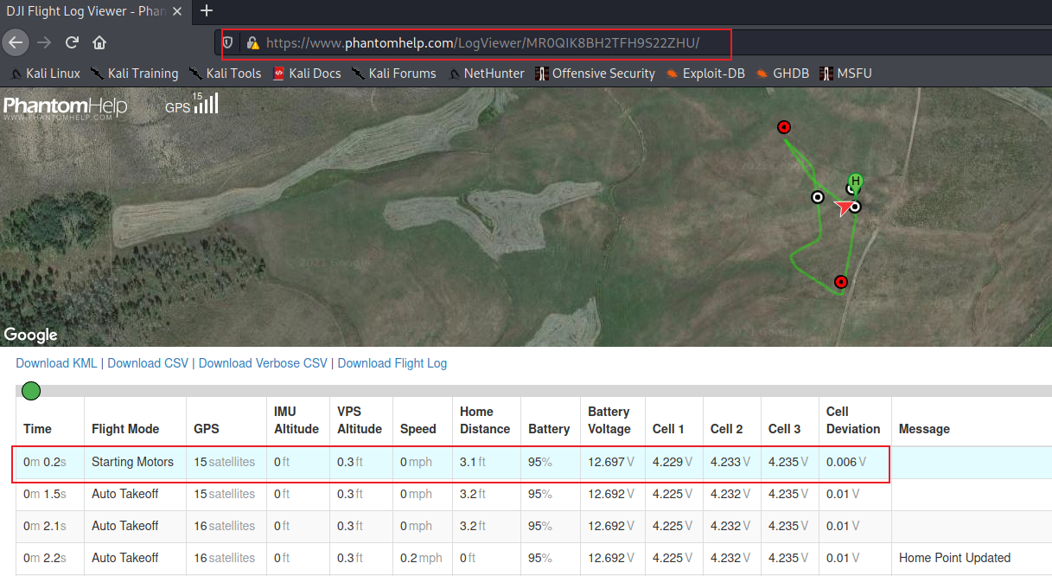
Inertial measurement unit (IMU)
visual Positioning System (VPS)
5 min 6 sec
Notes:
https://www.phantomhelp.com/LogViewer/MR0QIK8BH2TFH9S22ZHU

Slide 26
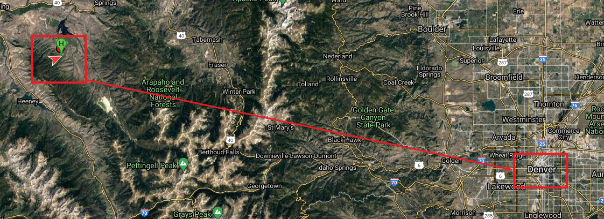
Find the location of the flight

Slide 27
How to verify the flight starting and ending time?
This is Colorado local time (UTC -6 hours)
UTC time: 2018-06-19 20:50:34
Did the flight last 4 hours 5 minutes and 6 second?
UTC time: 2018-06-19 16:55:40

Slide 28
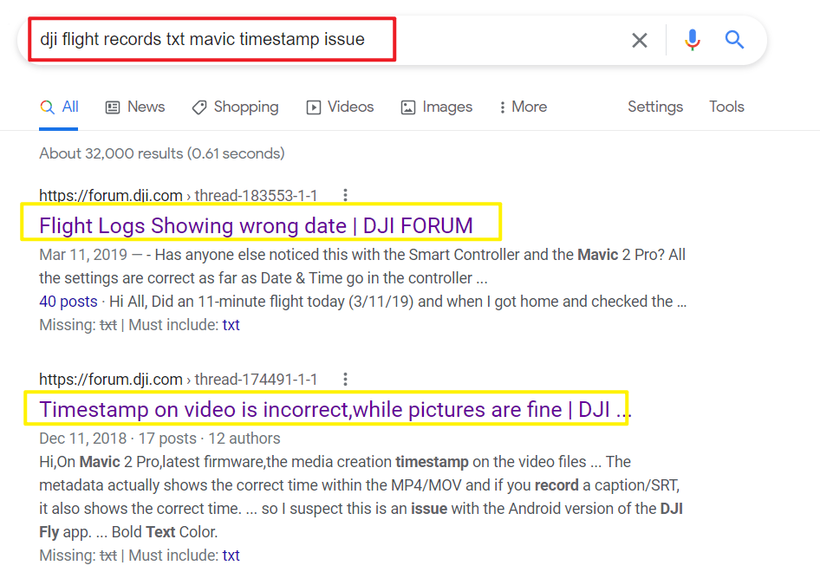

Slide 29
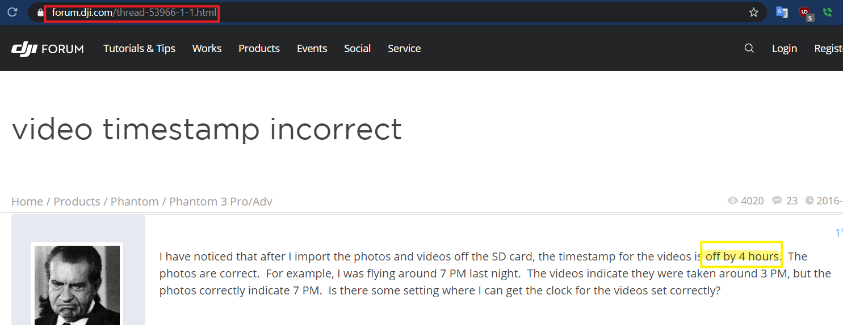
it seems the time zone did not set up correctly.

Slide 30
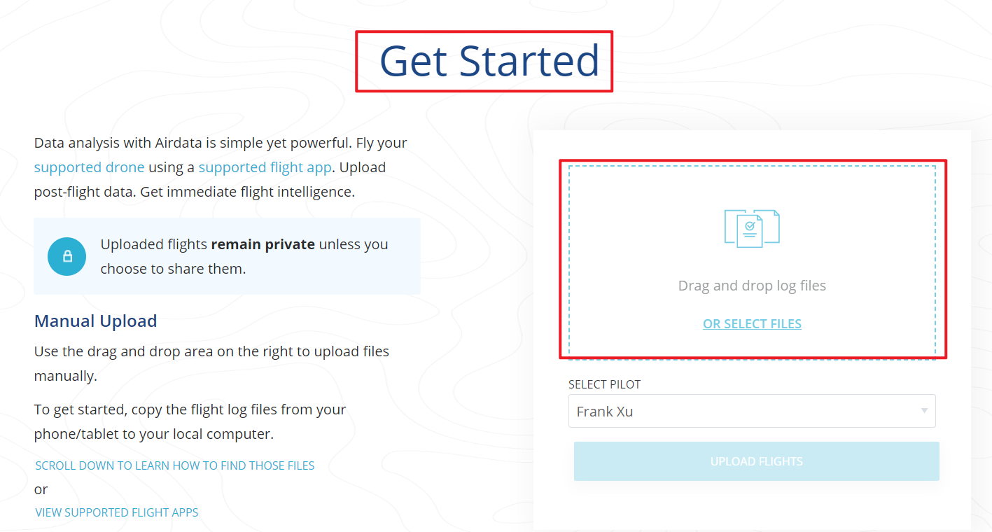
How to view a fight router information? (option 3: airdata.com)
Provide more information than options 1 and 2
Free for personal use
Need to register

Slide 31
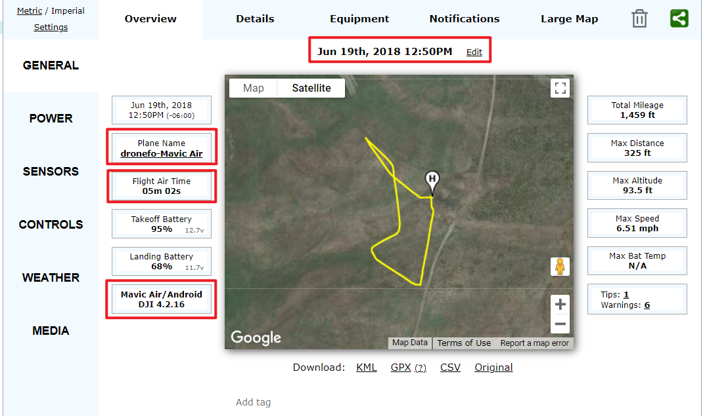
is the timestamp correct?

Slide 32
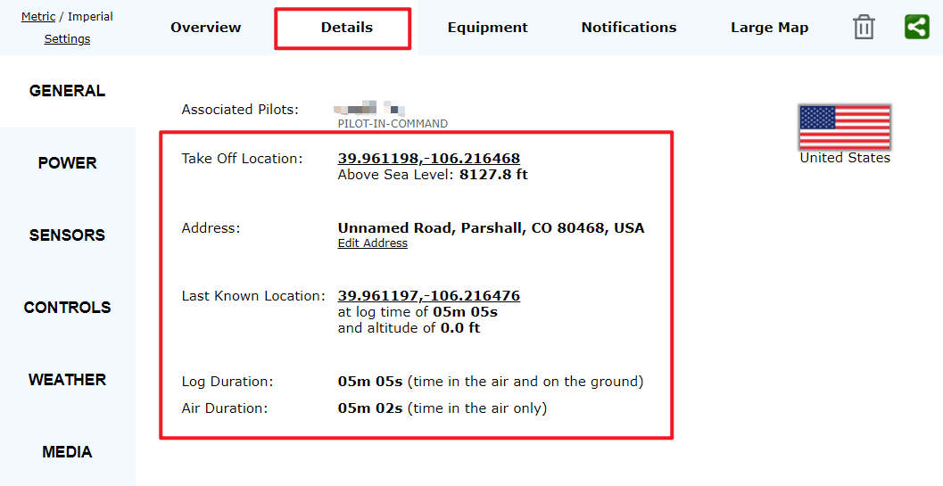

Slide 33
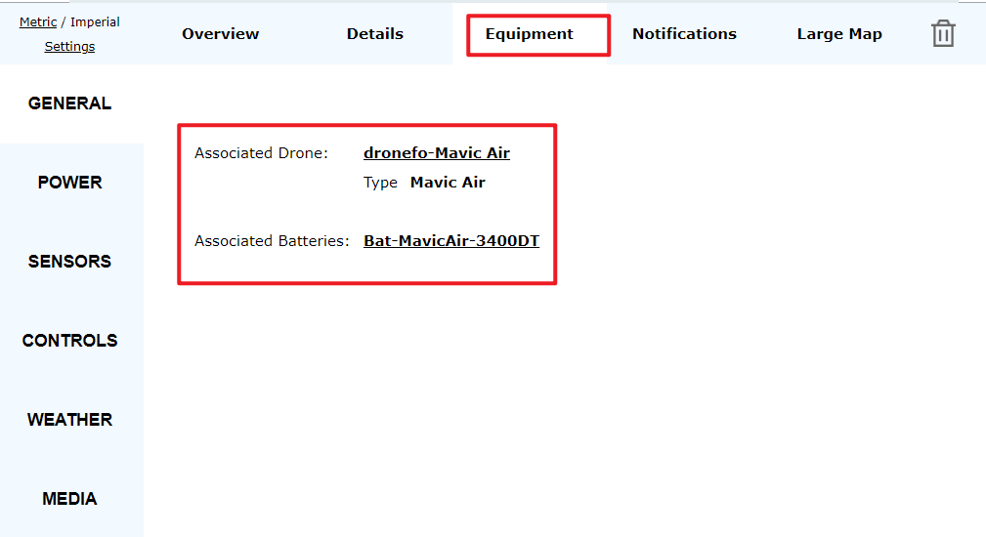

Slide 34
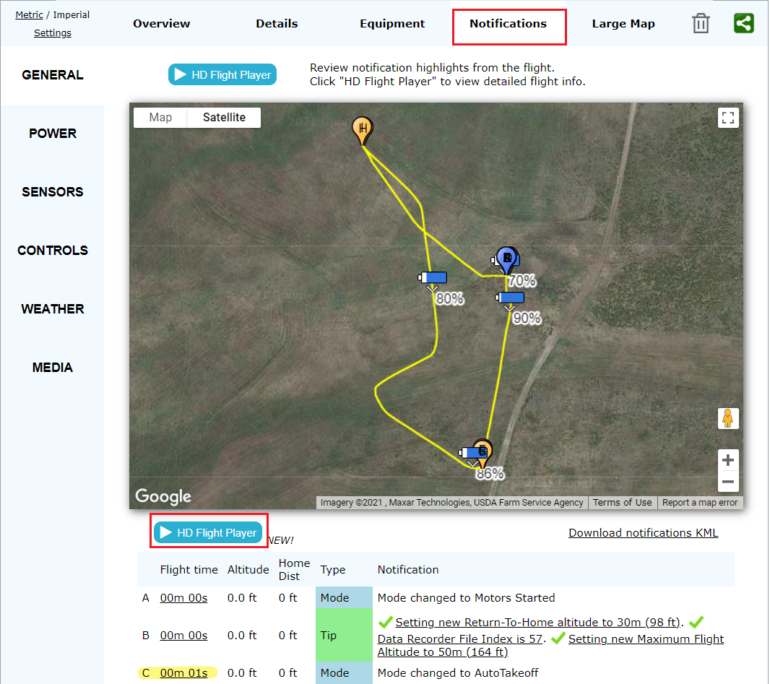

Slide 35
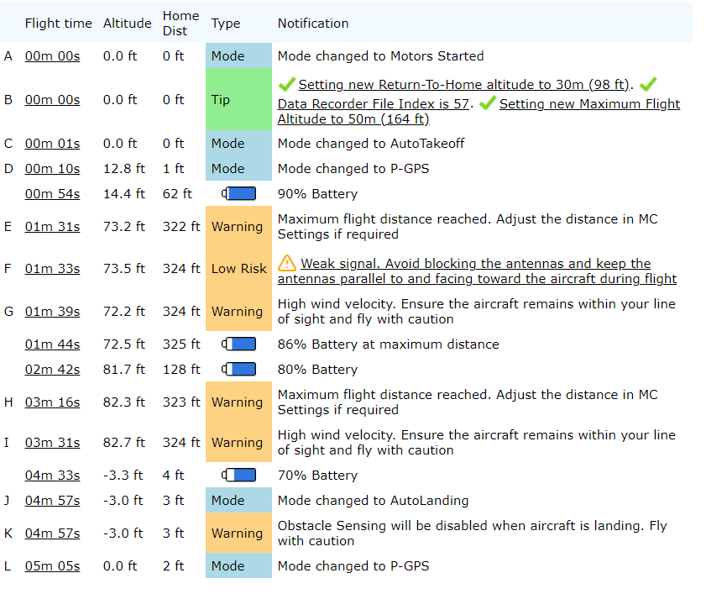
Start recording Mode
End recording GPS Position Mode

Slide 36
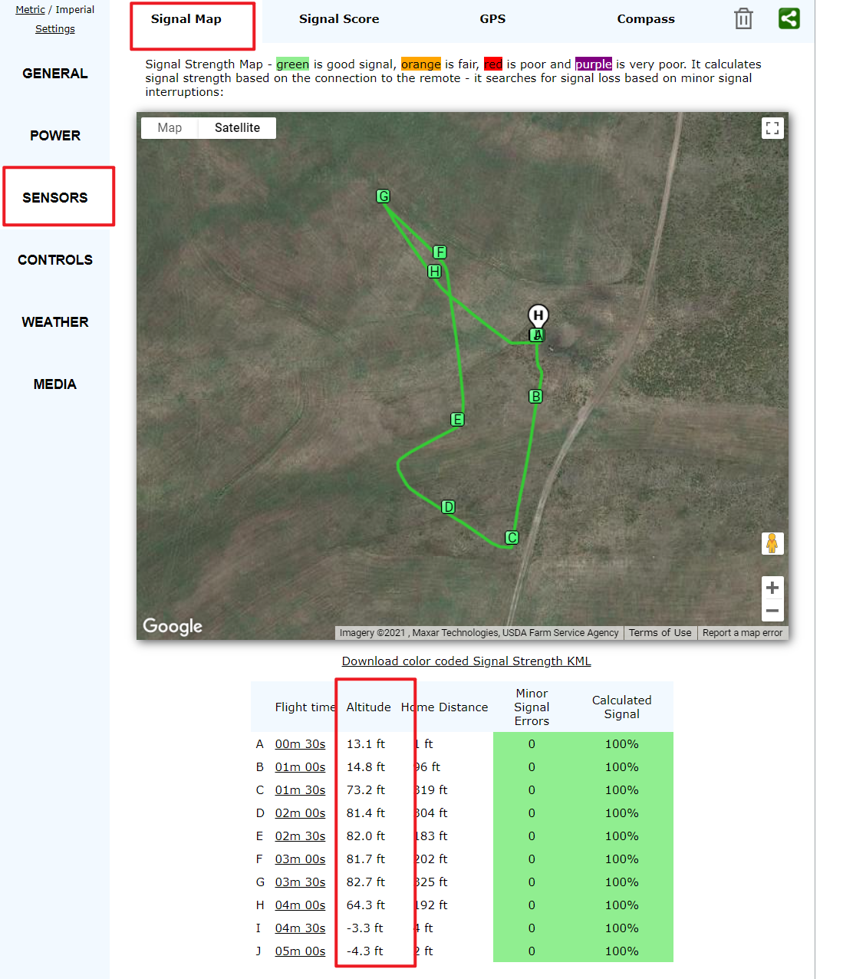

Slide 37
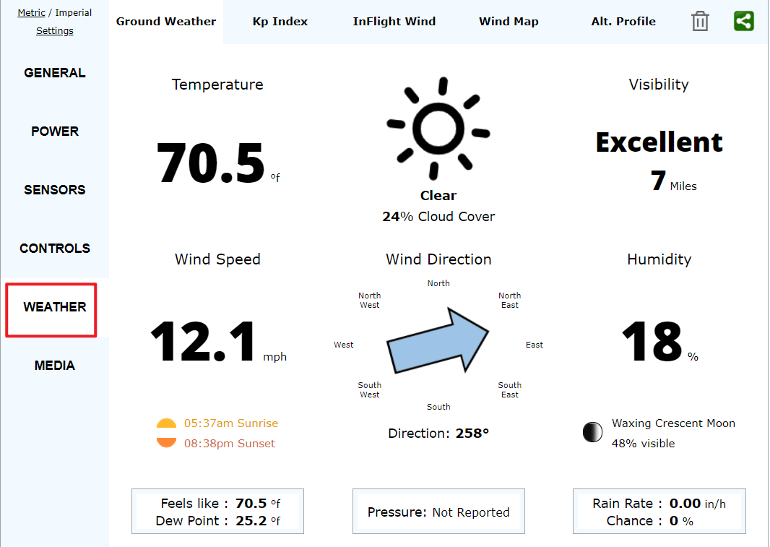

Slide 38
Analyze Video Cache *.mp4
Take off -> Landed

Slide 39
Where are flight videos (.mp4) saved?
Recorded flight videos
Definition of a flight video
TakeOff -> Landed
Not recording until Altitude >0

Slide 40
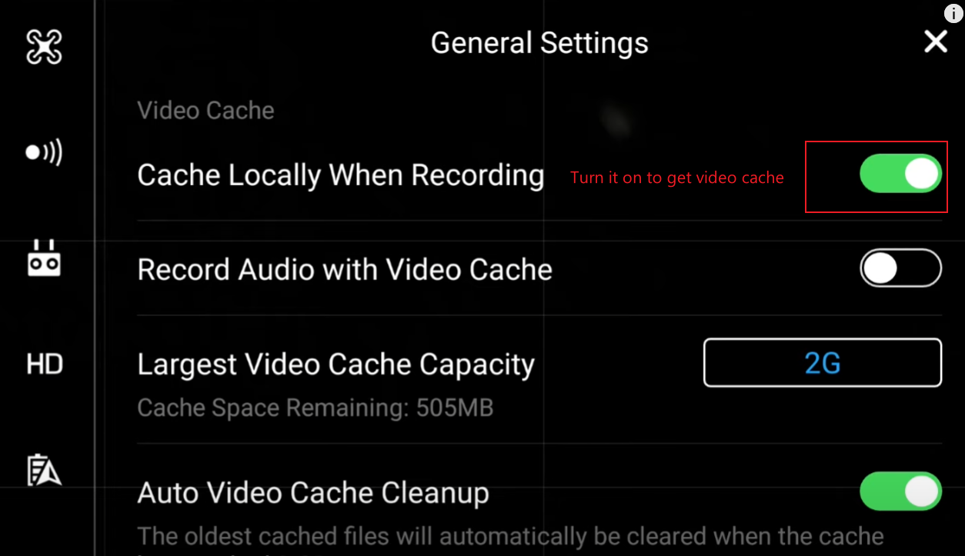
Video Cache setting

Slide 41
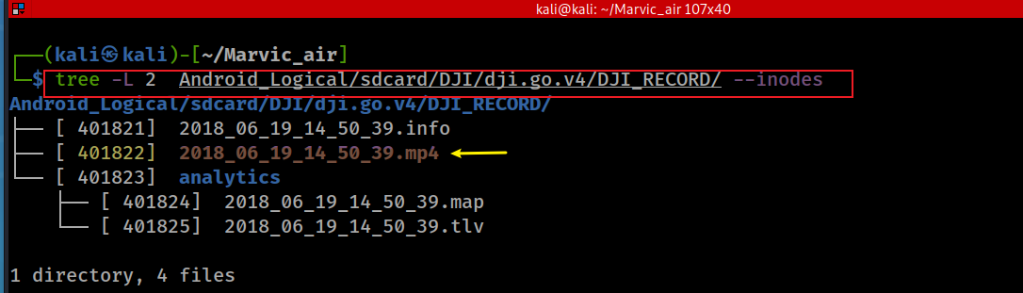
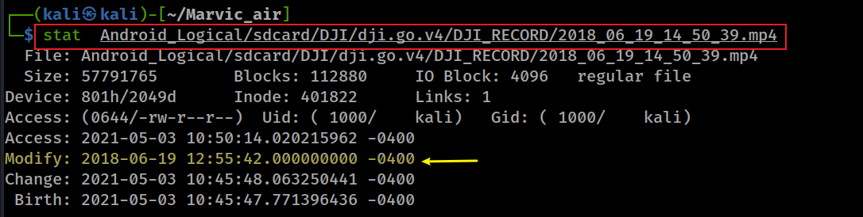
When was the flight video (.mp4) recorded?
Show folder/files and start recording time
UTC time: 2018-06-19 16:50:349
note: the original timestamp in the file name is 4 hours off
Show recording ends time
UTC time: 2018-06-19 16:55:402
Notes:
tree -L 2 Android_Logical/sdcard/DJI/dji.go.v4/DJI_RECORD/ --inodes

Slide 42
Start recording Mode
video recording started: + 05 sec
recording
video recording ended: + 02 sec
End recording GPS Position Mode

Slide 43
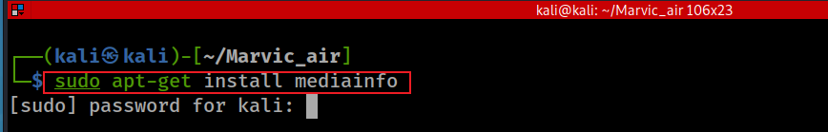
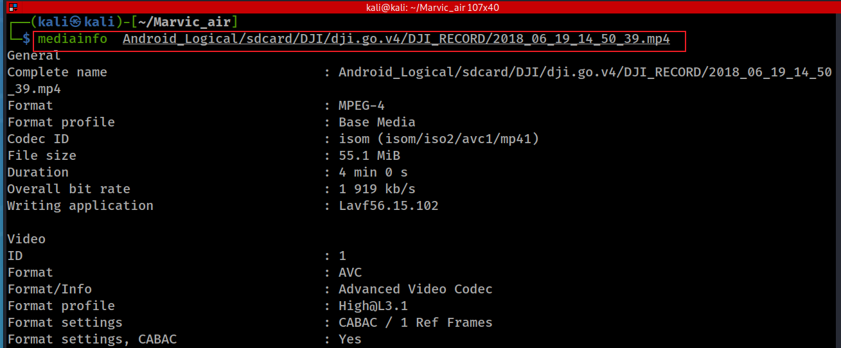
4 minutes
Notes:
sudo apt-get install mediainfo
mediainfo Android_Logical/sdcard/DJI/dji.go.v4/DJI_RECORD/2018_06_19_14_50_39.mp4

Slide 44
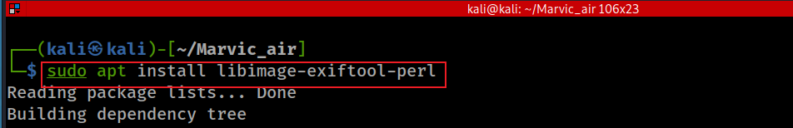
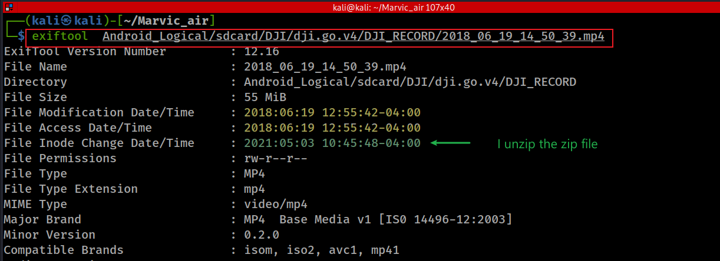
Notes:
sudo apt install libimage-exiftool-perl
exiftool Android_Logical/sdcard/DJI/dji.go.v4/DJI_RECORD/2018_06_19_14_50_39.mp4

Slide 45
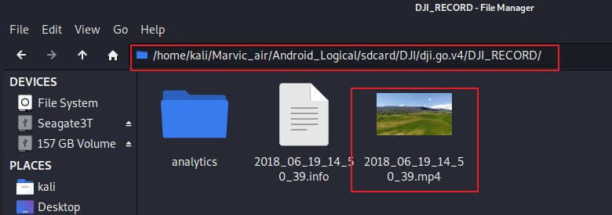
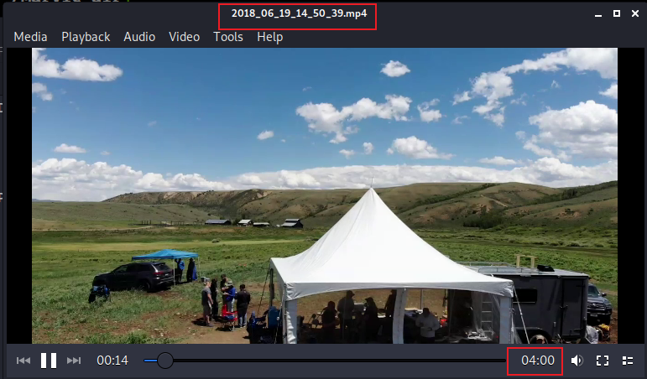
Play recorded flight
The video lasts 4 minutes
note: the video access time will be change after playing the video. Use stat command to verify

Slide 46
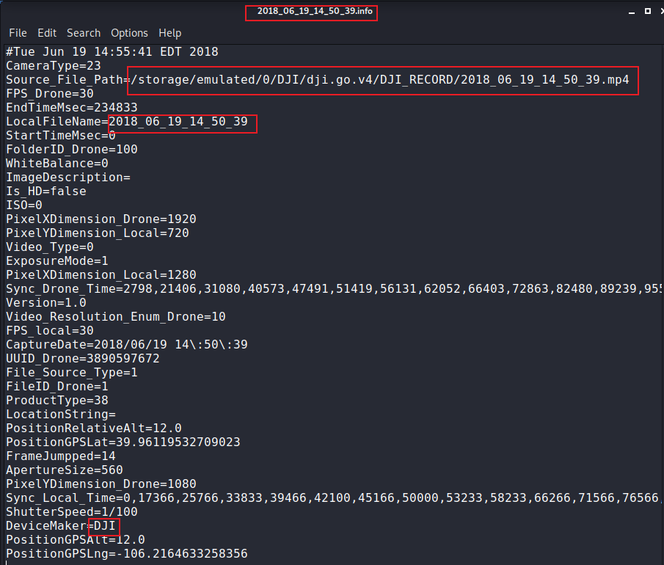
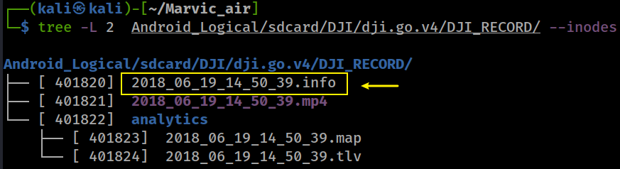
View information related to the video

Slide 47
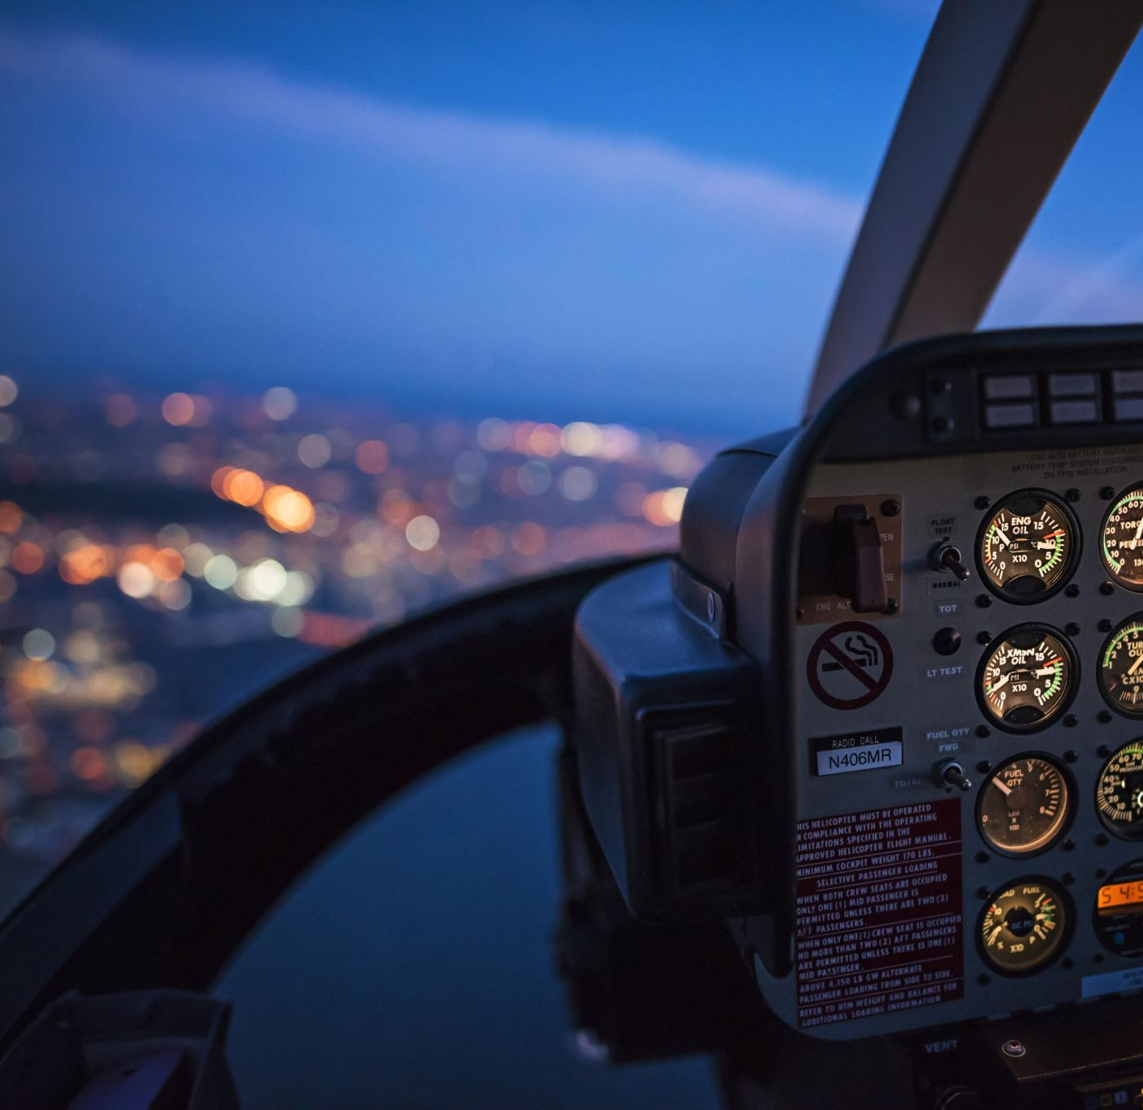
Analyze detailed flight record *.dat
Power on -> Power off

Slide 48
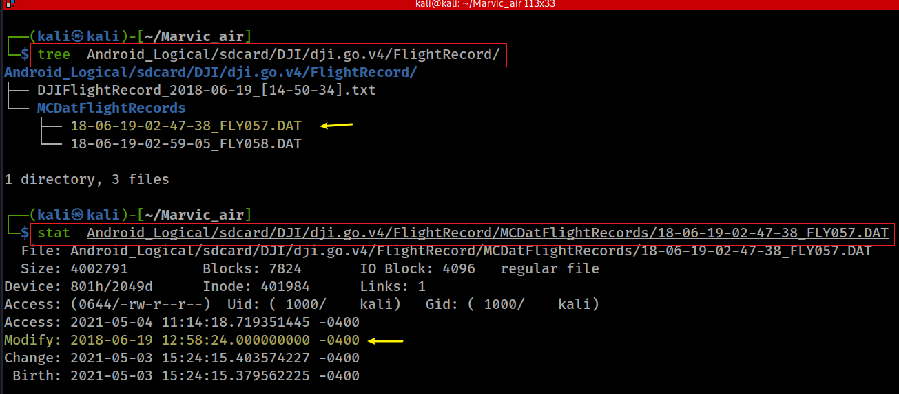
Power on: UTC time: 2018-06-19 16:47:38
~11 minutes
Power off: UTC time: 2018-06-19 16:58:24

Slide 49
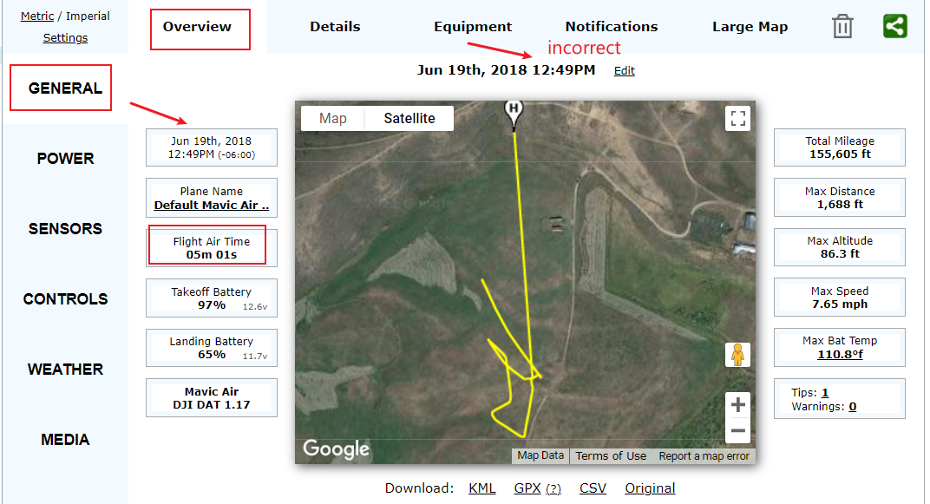
16:47:38

Slide 50
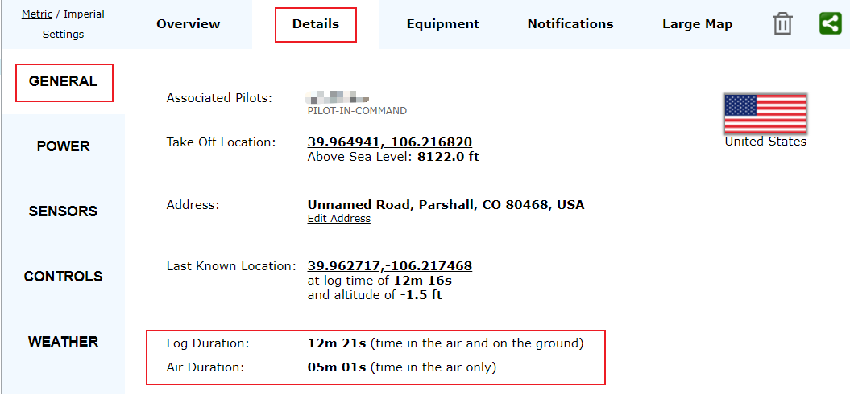

Slide 51
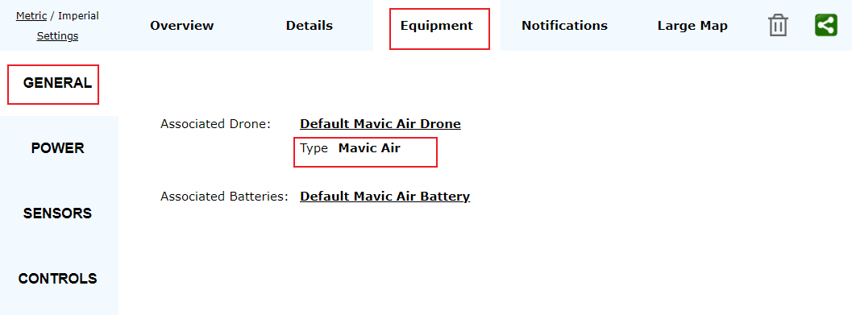

Slide 52


Slide 53


Slide 54

Analyze cached pictures

Slide 55

What is the location of cache pictures?

Slide 56

How many pictures contain people?

Slide 57

Any pictures taken on 2018-06-19?
Notes:
tree -L 1 Android_Logical/sdcard/DJI/dji.go.v4/
tree Android_Logical/sdcard/DJI/dji.go.v4/CACHE_IMAGE

Slide 58


The sequence of pictures were taken

Slide 59
Misc.

Slide 60

What was the last time dji.go.v4 updated?
Notes:
stat Android_Logical/sdcard/DJI/dji.go.v4/CACHE_IMAGE/thumb_33177fb665068406_1523611394000.jpg

